Slide 1

Weather Prediction MLOps System

Slide 2

Problem Statement
Weather forecasts drive real, time-sensitive decisions — from commuting and event planning to logistics and emergency preparedness — yet most publicly accessible forecast tools are static, black-box services that offer no visibility into model performance, no ability to retrain as conditions change, and no mechanism to detect when predictions start to degrade. In practice, weather-dependent systems need not just a prediction, but a trustworthy, maintainable, and monitored prediction pipeline: one where the model's accuracy is tracked over time, retraining is automated as new data arrives, and drift in incoming data or model performance is caught before it silently erodes decision quality.
This project addresses that gap by building an end-to-end MLOps pipeline — not just a weather model — that predicts adverse weather conditions (e.g., rain/bad weather) at a given location using historical station data (NOAA GHCND) and live observations/forecasts (NWS). The core challenge is less "can we predict rain" and more "can we operationalize that prediction responsibly": automating data ingestion and feature versioning, tracking experiments and promoting only vetted champion models, serving predictions through a containerized real-time API, and continuously monitoring the deployed model for data drift and performance decay — with alerting when it degrades.

Slide 3
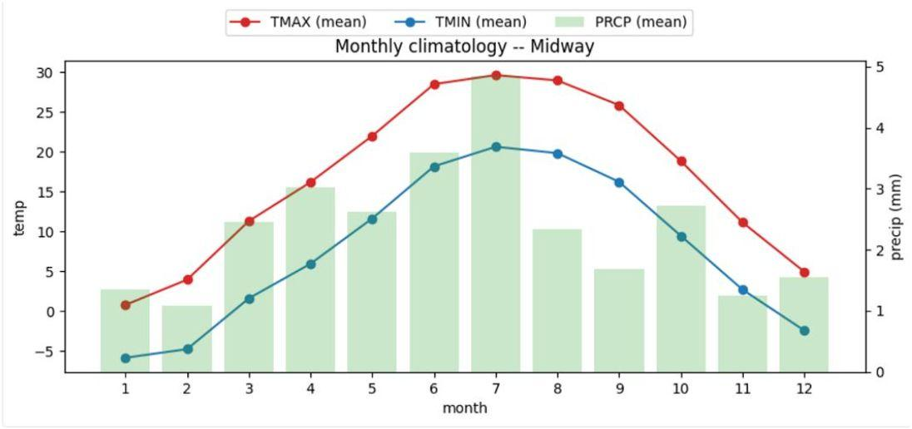
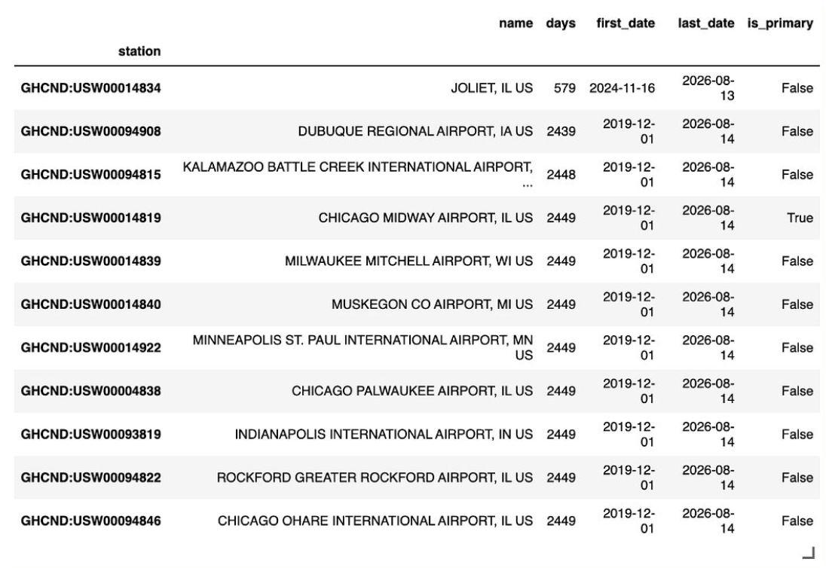
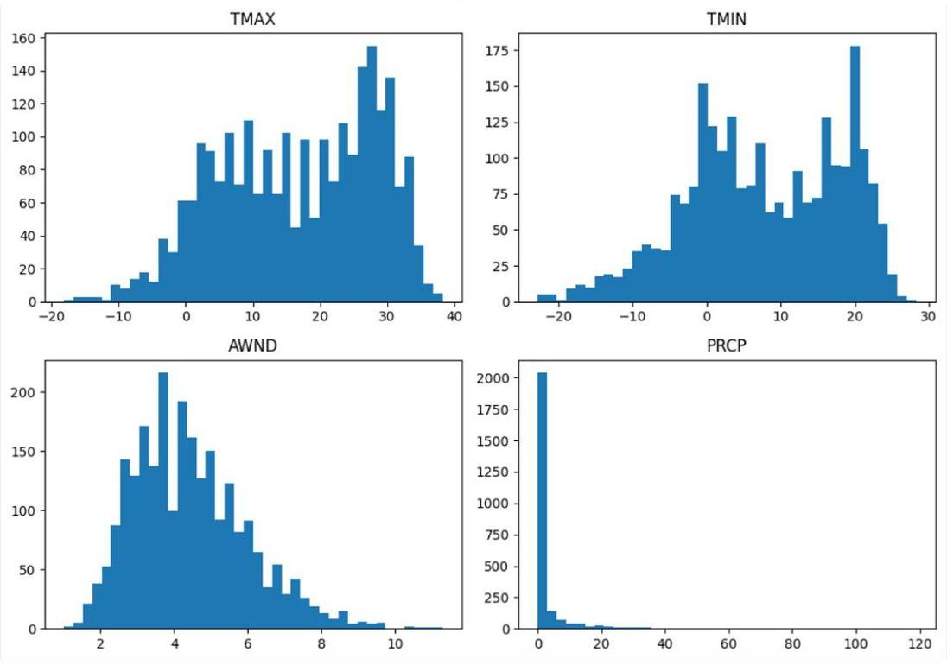
EDA
Midway Temperature Seasonality
Station Date Coverage
Midway Feature Distributions

Slide 4
Data Pipeline
Instantiated an automated data pipeline pulling in data from 11 stations, 12 datatypes covering different aspects of the weather (Temperature(s), wind speed(s) and direction, condition flags, etc..) into a bronze layer.
Stations in and external to Chicago - IA, WI, IN, MI airports.
PK'd on station, date pairs.
Data fetched from December 2019, with updated data coming in nightly on an automated job.

Slide 5
Baseline Model and Evaluation Metric
Gabe to add details

Slide 6
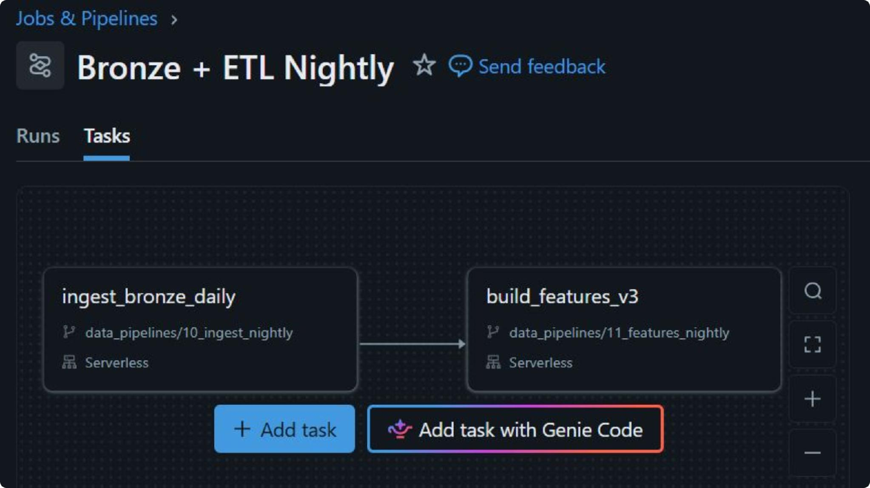
Nightly Data Pull + ETL
While historical data for weather is relatively static, prior days can be revised. Nightly job pulls fresh bronze layer data and then appends to the v3 features table (final version of our features table).

Slide 7
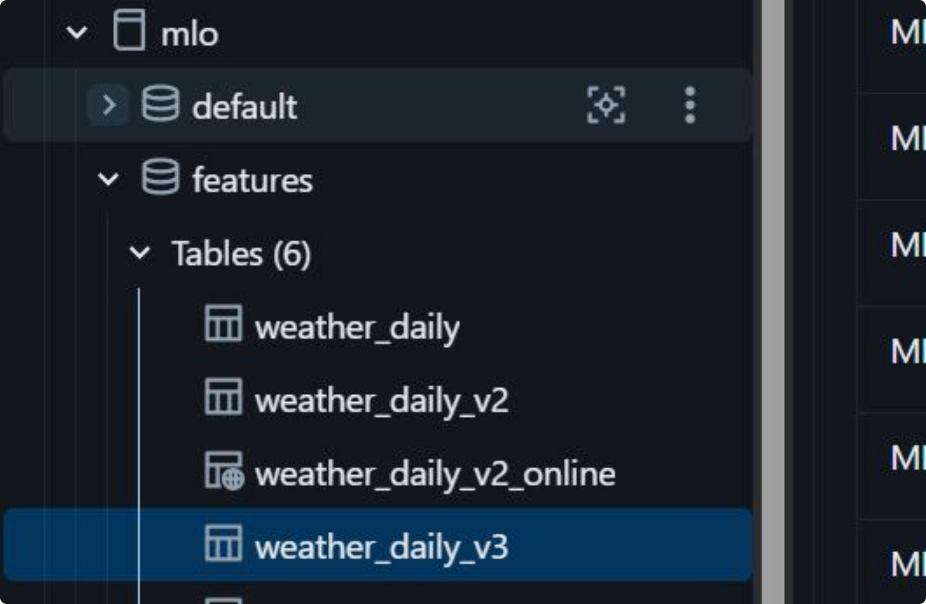
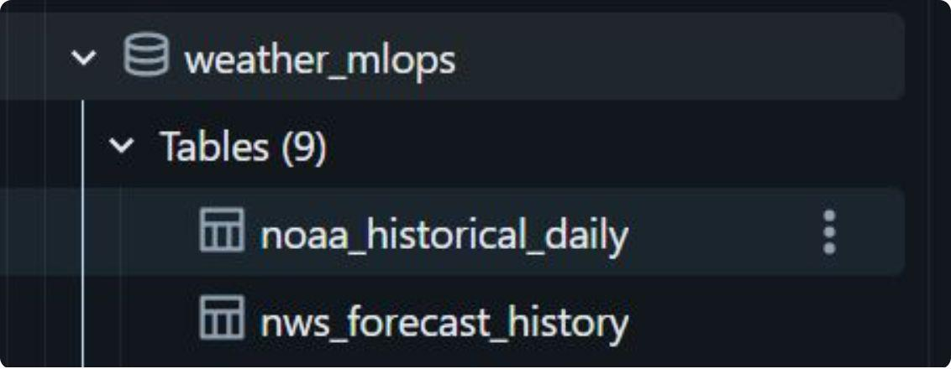
Feature Engineering
Goal
Engineered to 44 features, 46 columns total
Window features, direction embedding, seasonality components
Goal is predicting precipitation at Midway tomorrow (T+1).
2,445 rows; 1,826 usable once joined to labels (the label table is pinned to 2020–2024)
Label is shifted UP to t+1, meaning at time T all features are leak-free.

Slide 8
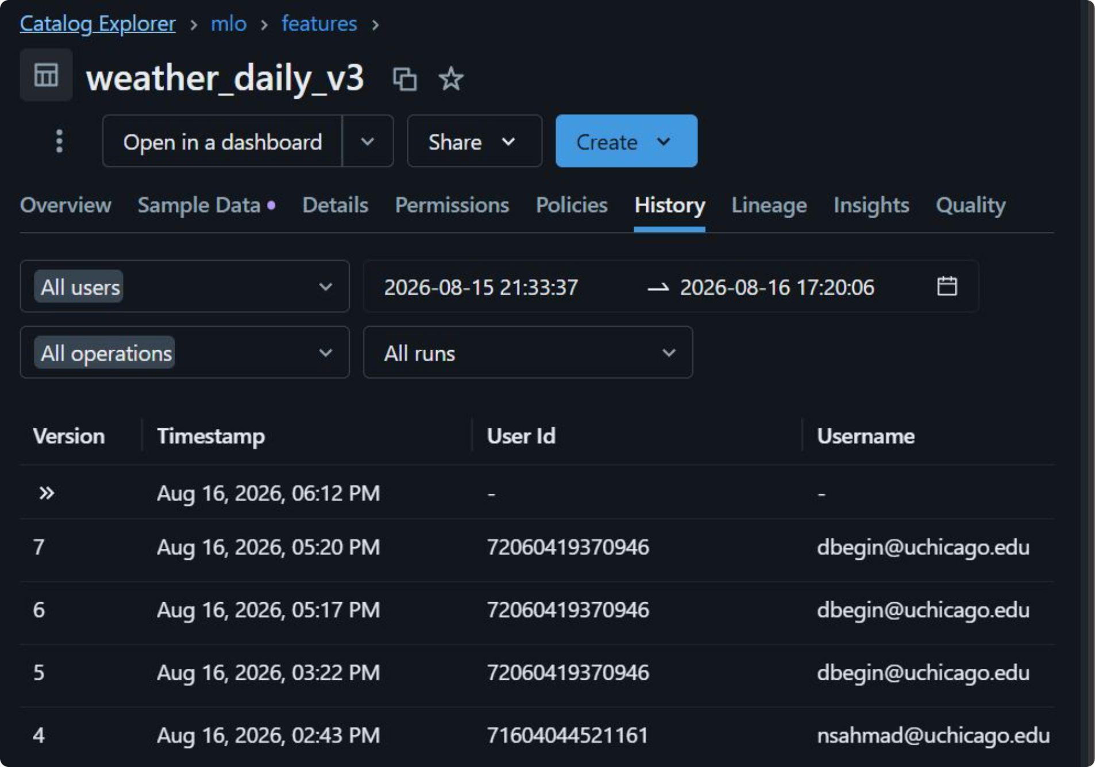
Data Versioning
Different tables map to different feature sets (v1, v2 and v3 each resulting in better-performing models)
Delta Tables version the data over time, allowing data lineage
Limitation: Data will eventually be deleted and un-recoverable.

Slide 9
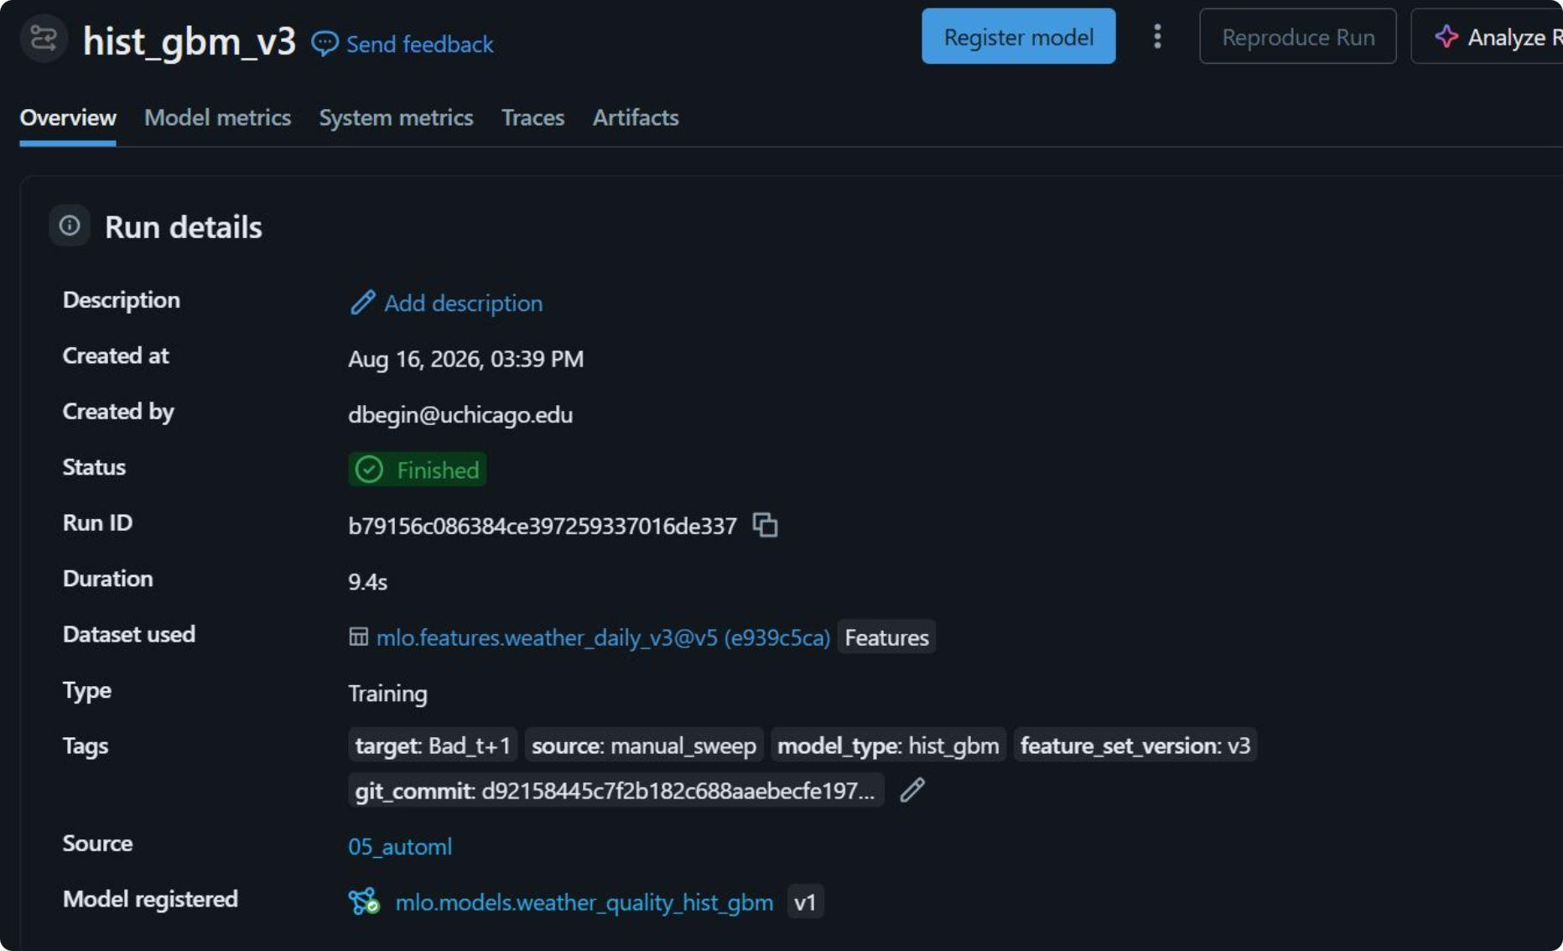
Data Versioning 2
Experiments log not only the feature version but also the delta version of the table being used. Experiments contain a git commit, allowing reproducibility of the code that produced them*.
Git commit allows tracking of which version of the model code submitted the run.
Feature_set_version is logged by the experiment notebook.
Gate depends on human review during promotion to ensure conformity.
*assumes that the entire project remains on one git repository.

Slide 10
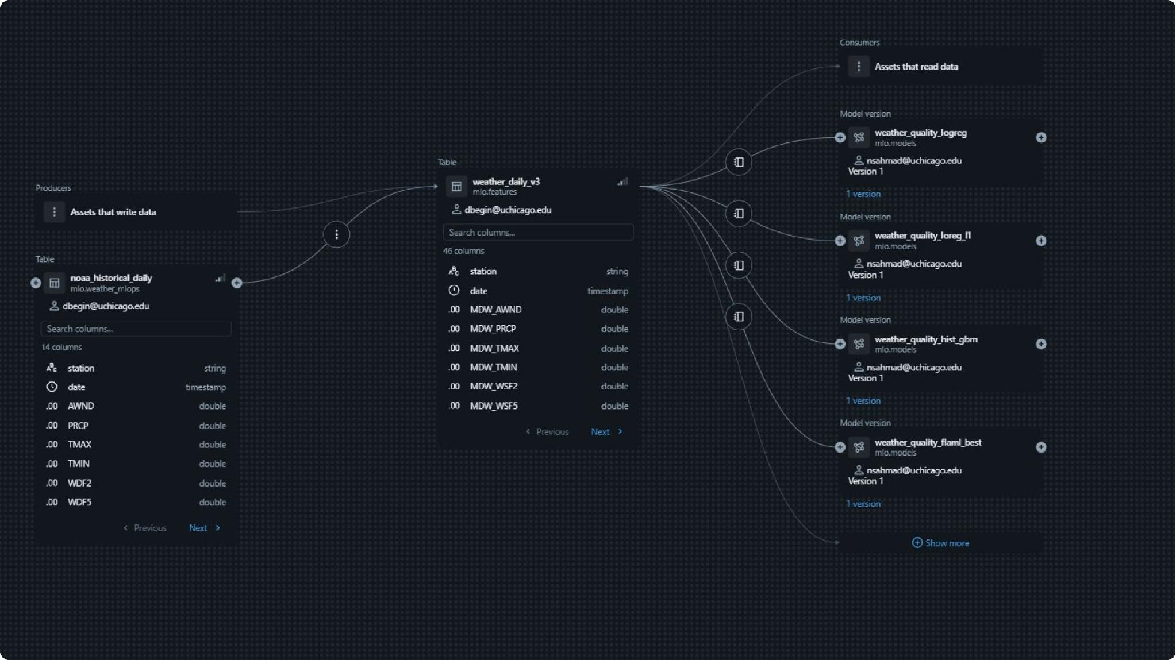
Lineage shows where features come from and where they're consumed, but it's object-level, not version-level — it can't tell you which version of weather_daily_v3 a model trained on, and that table updates nightly. That's why the Delta version is logged on the MLflow run instead.

Slide 11
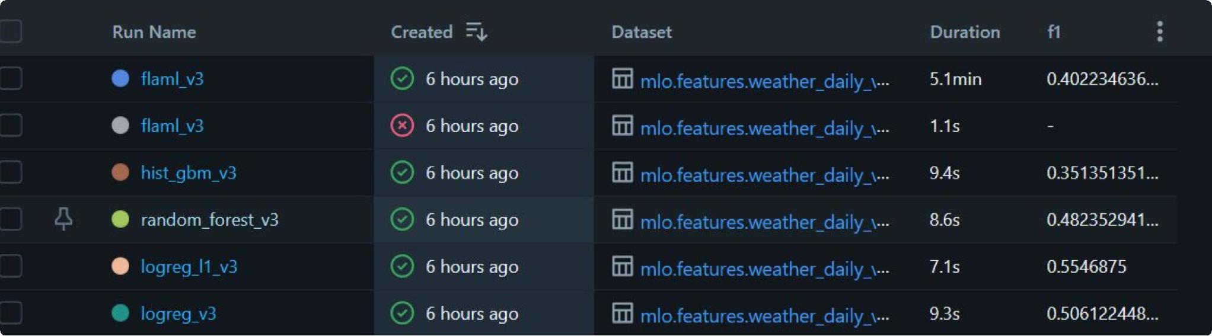
Experiment Tracking
MLFlow is native in databricks, meaning easy experiment tracking.
Stats produced: f1, accuracy, recall, precision.
In the context of a high-imbalance classification problem like precipitation prediction, accuracy is not the best measure. Since promotion is manual, however, promotion can be based on all the available metrics as is seen fit by decision makers.

Slide 12
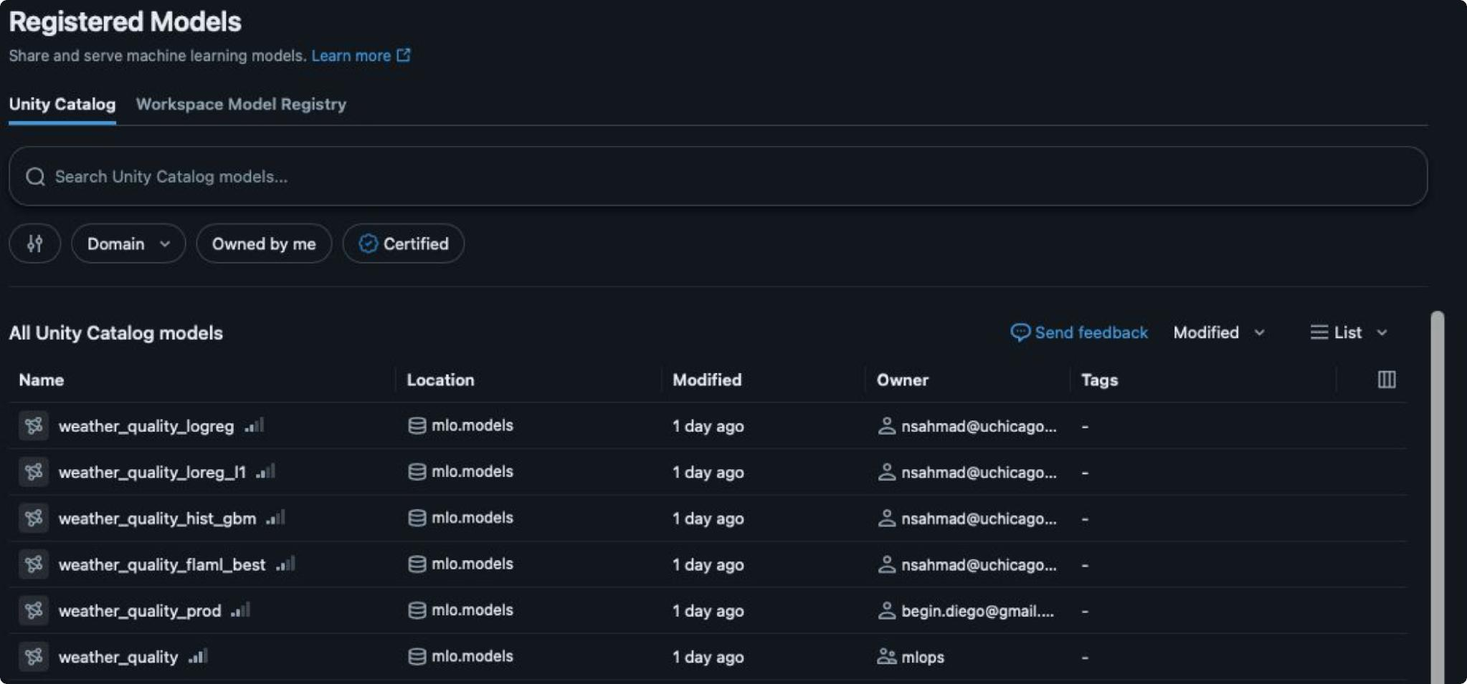
Deployment: Register your model in Unity Catalog
From experiment tracking, we can take an experimental artifact and promote this asset into a versioned, governed model. Unity Catalogue hosts our models and data versions simultaneously while allowing us to permission and trace lineage very simply.

Slide 13
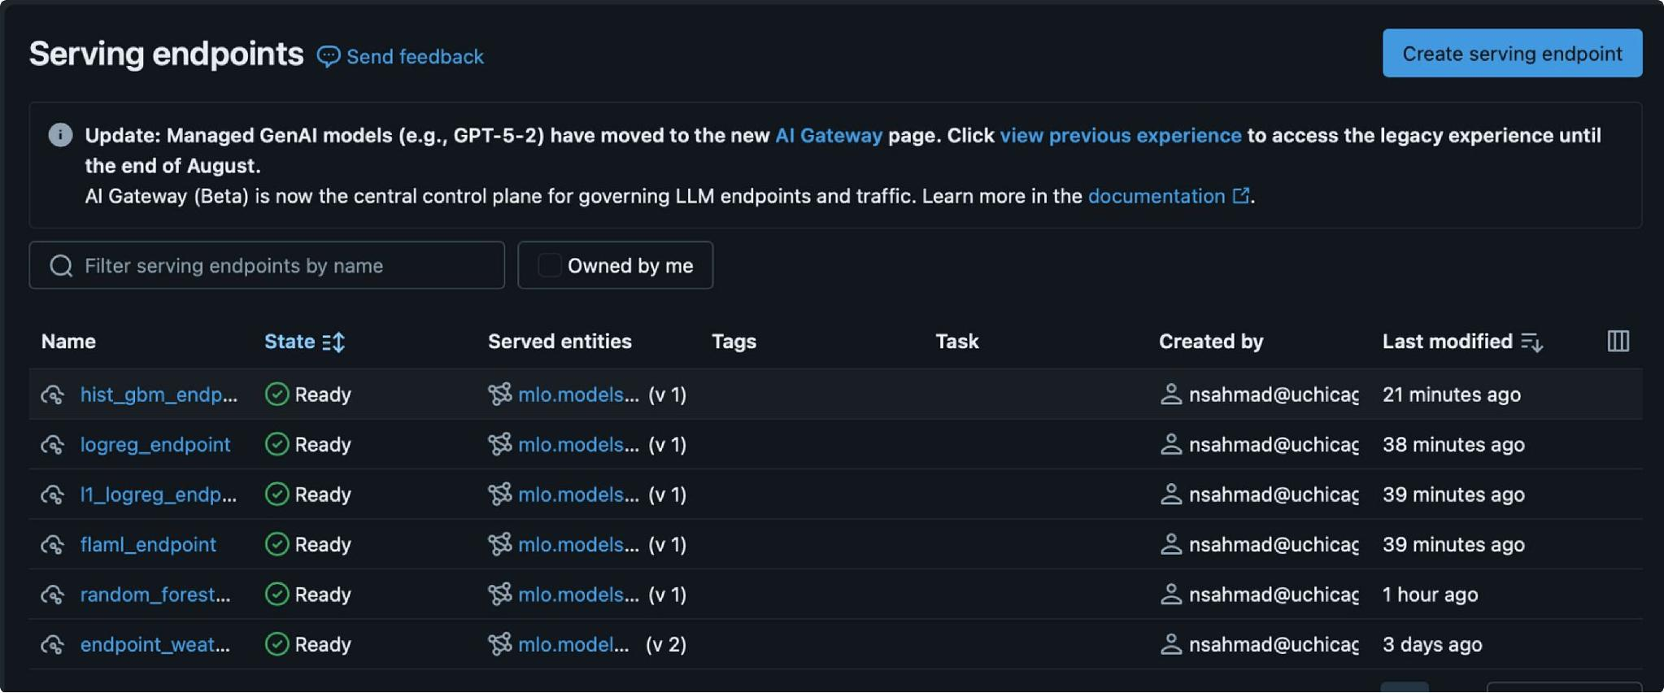
Serving Endpoints
Goal: Databricks streamlines the entire deployment process.
By host our model on Databricks, we don't have to Dockerize.
Logging to MLflow captures the environment, and serving the model builds a container from that spec on our behalf.
We are able to easily track registered versions of our models, and registered versions also let one endpoint host a champion and challengers behind a single URL with a traffic split. Should we move our model off of Databricks, we would look to dockerize.

Slide 14
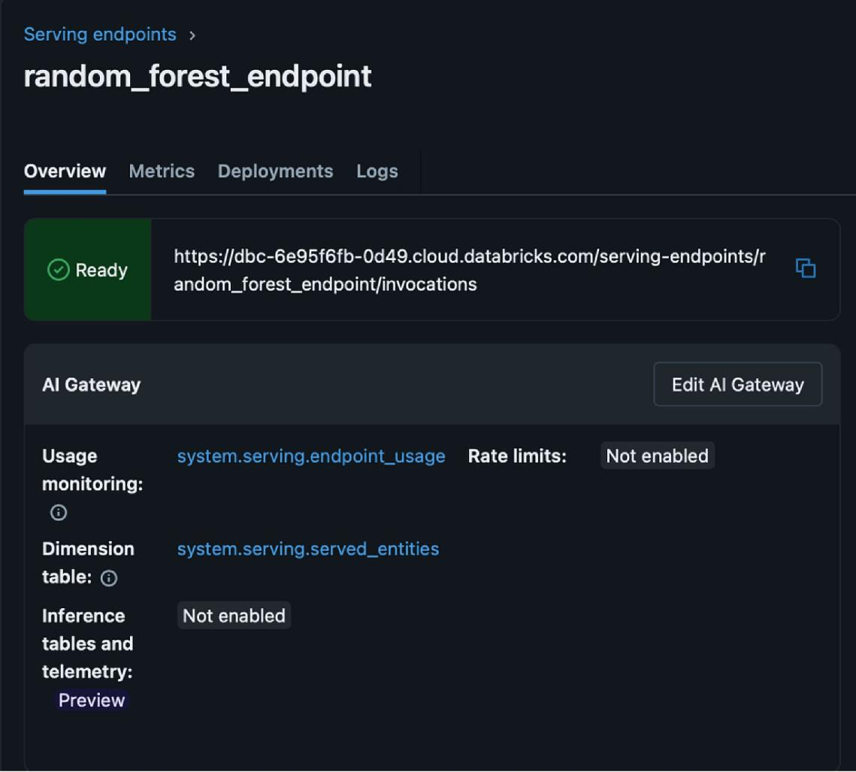
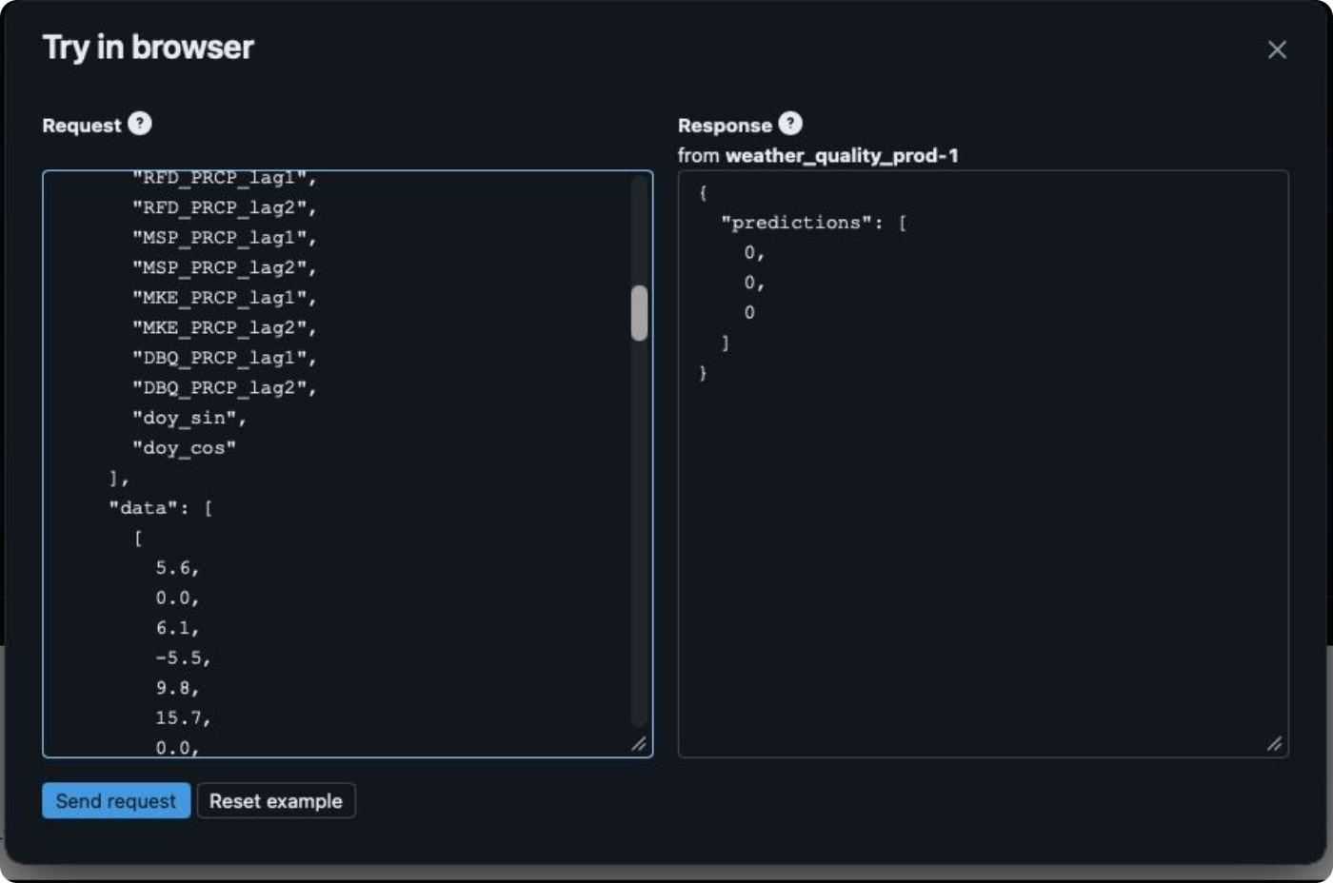
Databricks also allows us to test our endpoint in the browser, quickly allowing us to spin up our model, establish that our model is running, and begin testing.
Model Endpoints
Serving endpoints can log requests and predictions to a Unity Catalog inference table automatically, which feeds Evidently without any capture code in the scoring path. But inference tables require an external storage catalog, and our workspace uses default storage, thus we decided to implement the capture layer ourselves. We took on the write path and its failure modes, opting for a fail-close mode, and received schema control and portability in exchange.

Slide 15
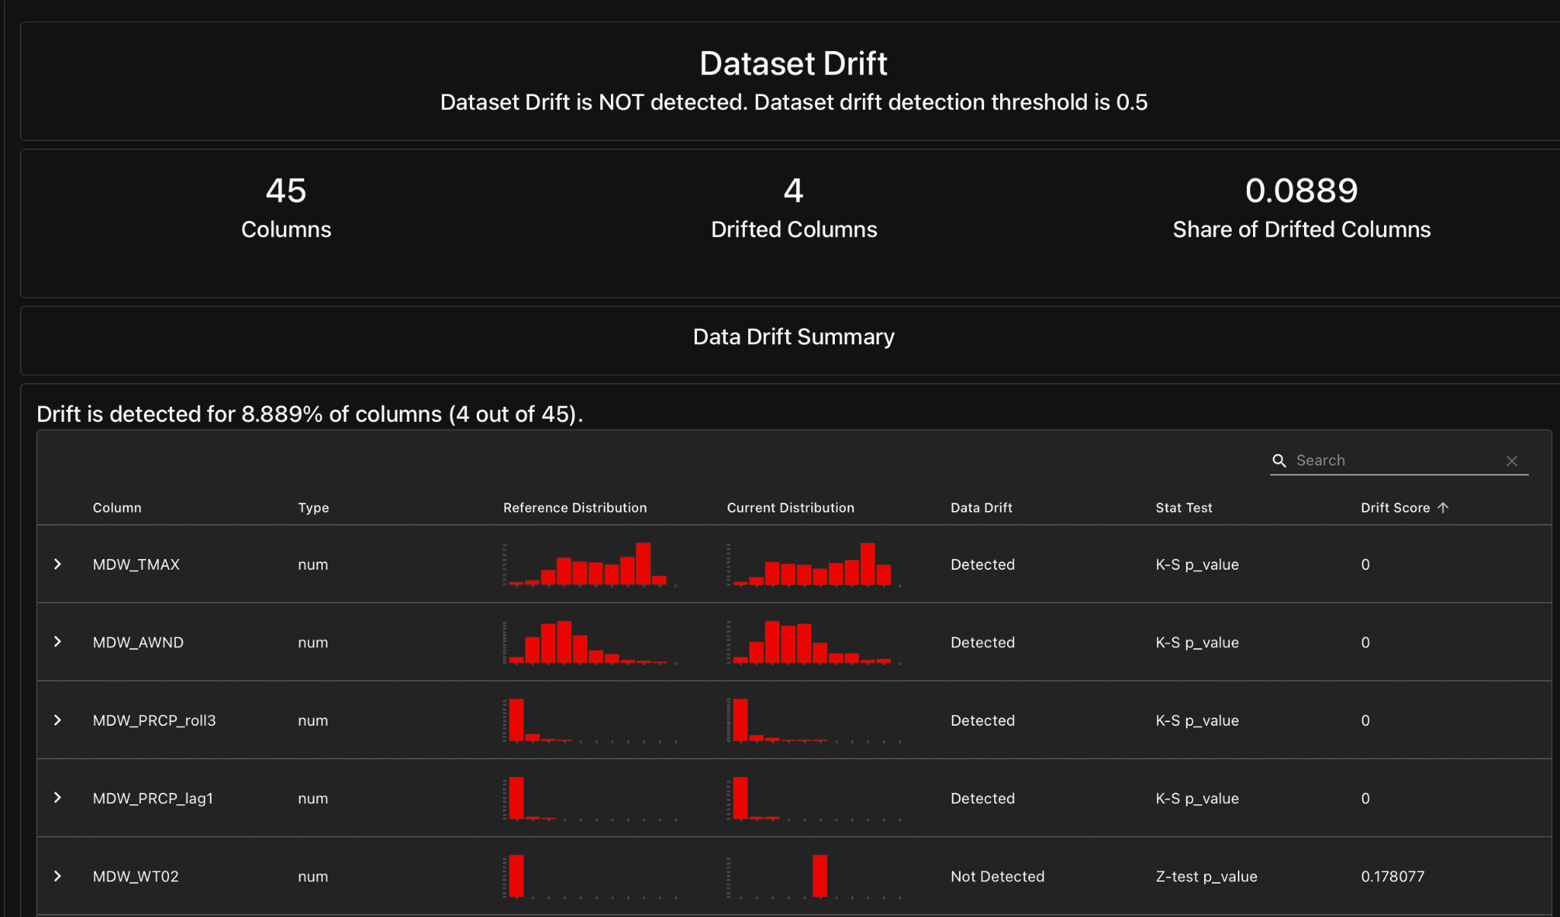
Evidently AI Report on Drift Monitoring
Evidently AI is a library which allows us to monitor, evaluate and test our production models. We were able to assess that there was drift in 4 of our features, but with a threshold of 0.5, there was no dataset drift detected.
these flags reflect our reference/current split rather than real temporal drift, so we're using them to identify which features to keep an eye on in simulated drift scenarios.

Slide 16
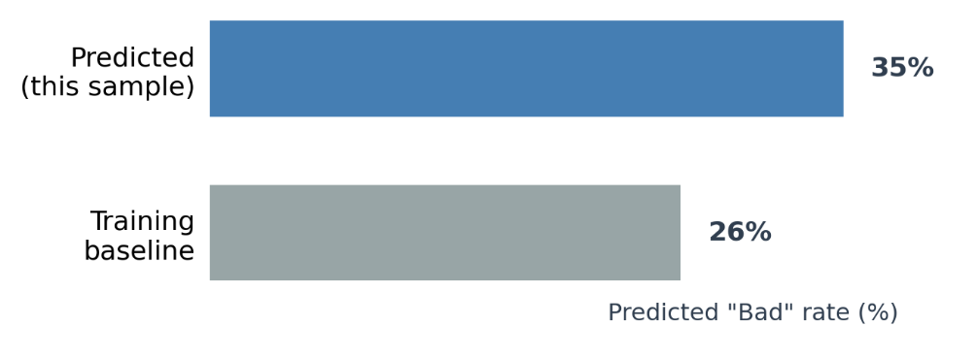
Baseline Validation
Passed the real test dataset through the deployed API (logreg_direct_endpoint) and validated results against the monitoring baseline.
Endpoint returned a healthy mix of predictions: 35% "Bad" vs. a 26% training baseline
This confirmed the model responded correctly to real, undrifted production data before any stress test began.

Slide 17
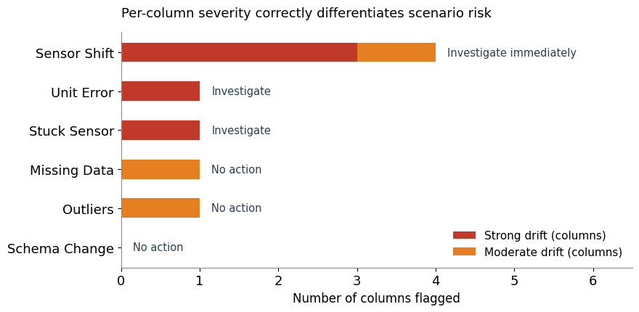
Stress-Test / Drift Simulation
Next we artificially corrupted the test dataset across six realistic failure modes:
Sensor value shift
Missing data (~30% nulled)
Schema change (renamed/dropped columns)
Unit conversion error
Stuck/frozen sensor
Statistical outliers
Each applied to 500 real feature rows before being sent to the deployed model.

Slide 18
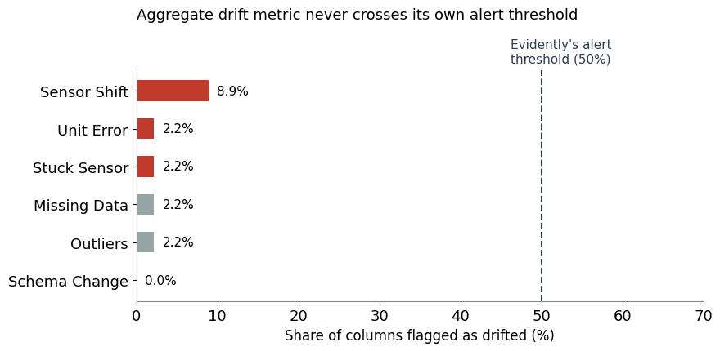
Anomaly Verification
We sent each drifted dataset to the deployed model and verified how the monitoring dashboard responds.
The dashboard's flag reported only 8.9% of columns drifted
Per-column severity check that correctly escalates real risk: Sensor Shift → "investigate immediately," while lower-risk scenarios correctly stay quiet.

Slide 19
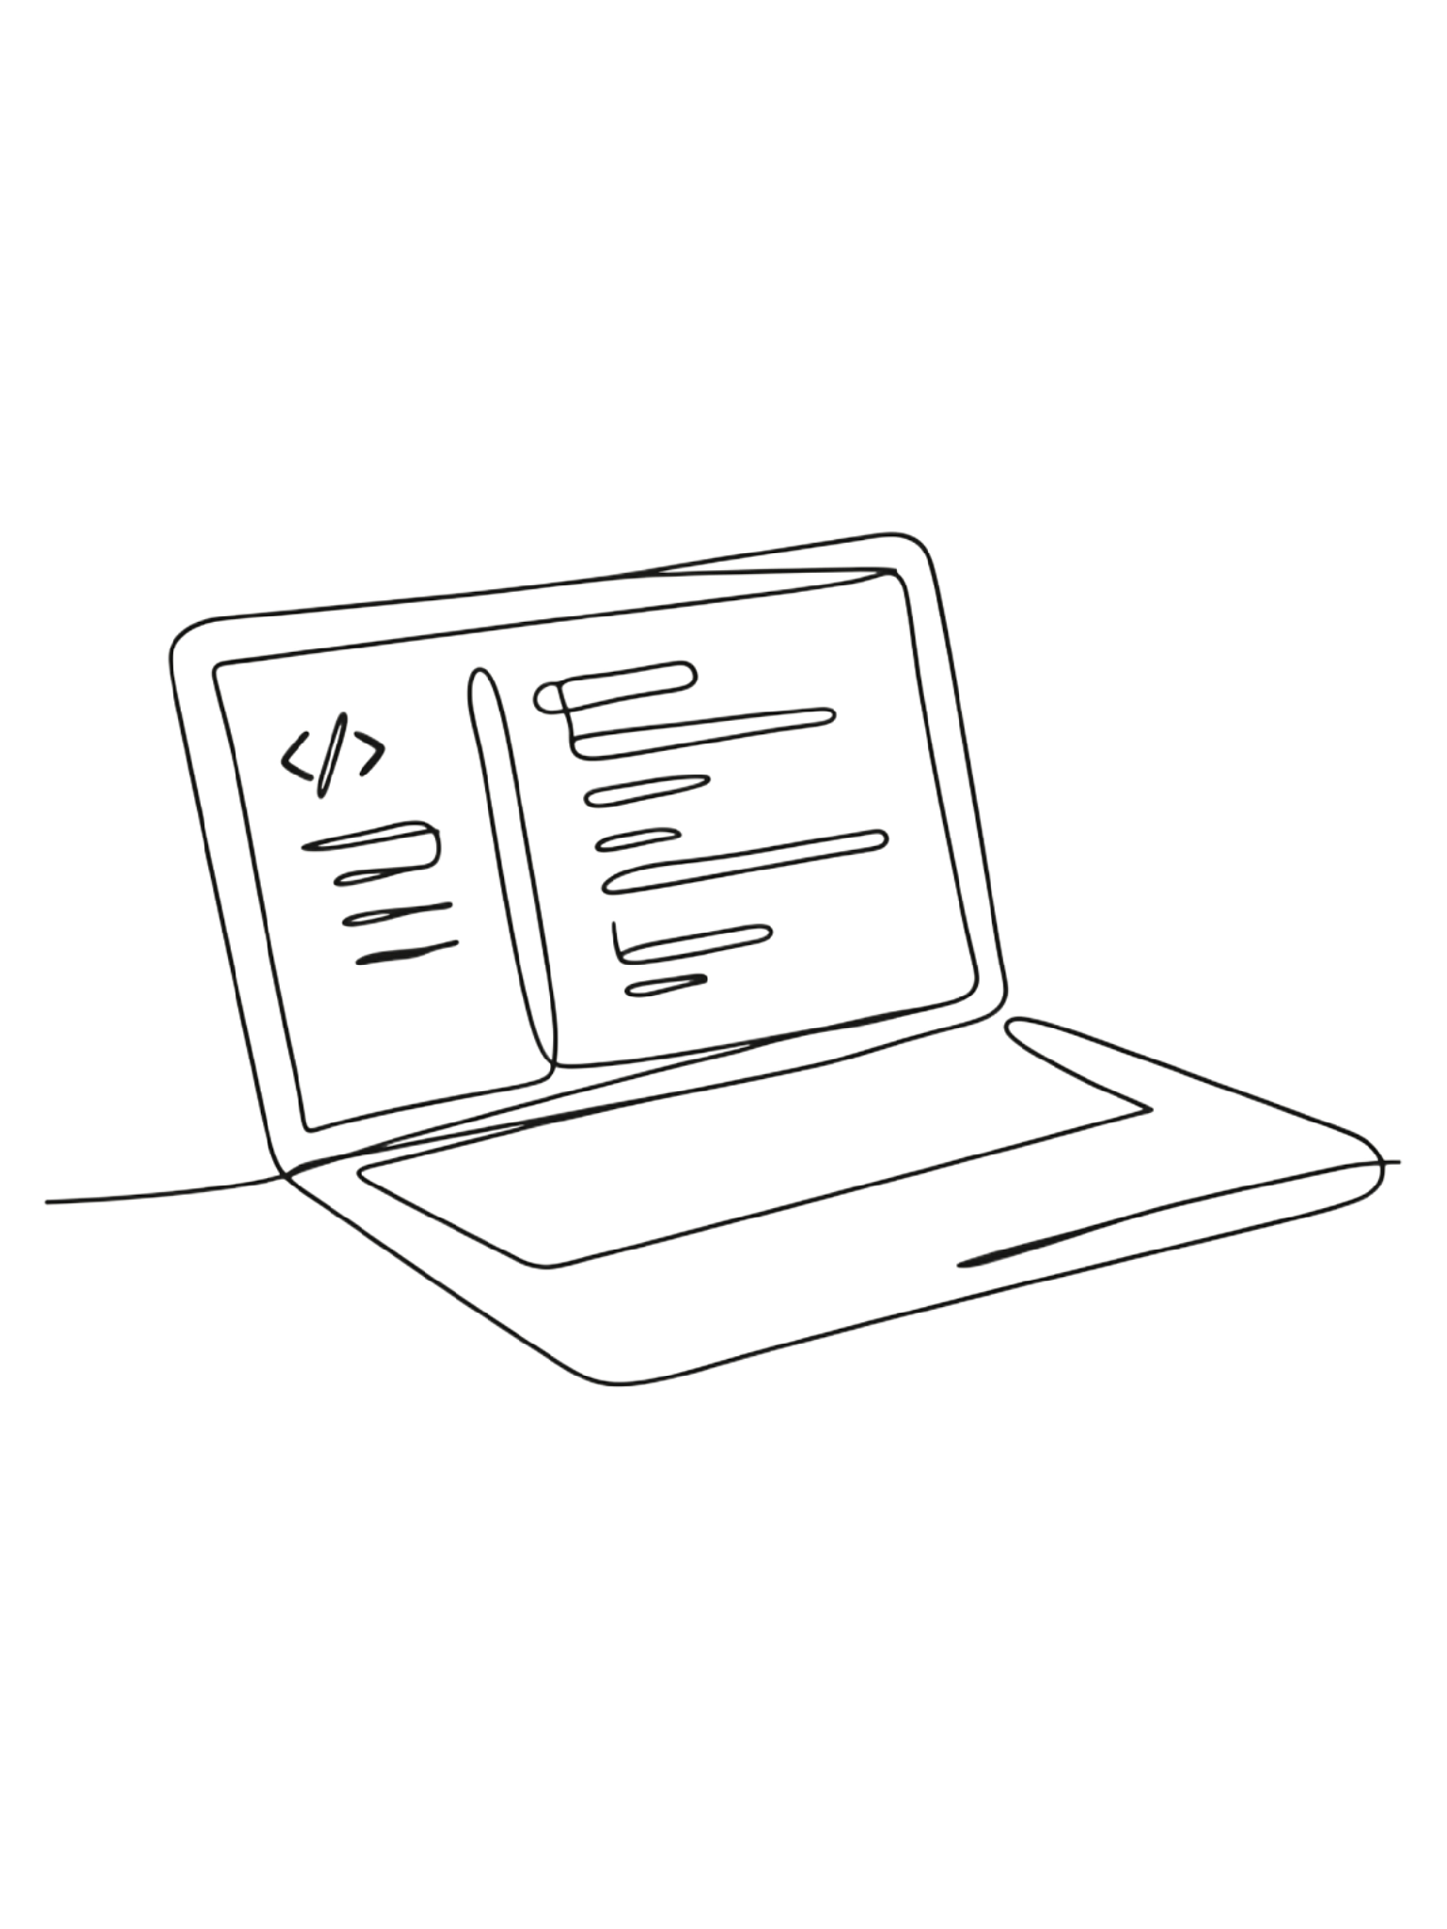
Repo Link
https://github.com/lilykendall/adsp32021_mlops_final

Slide 20
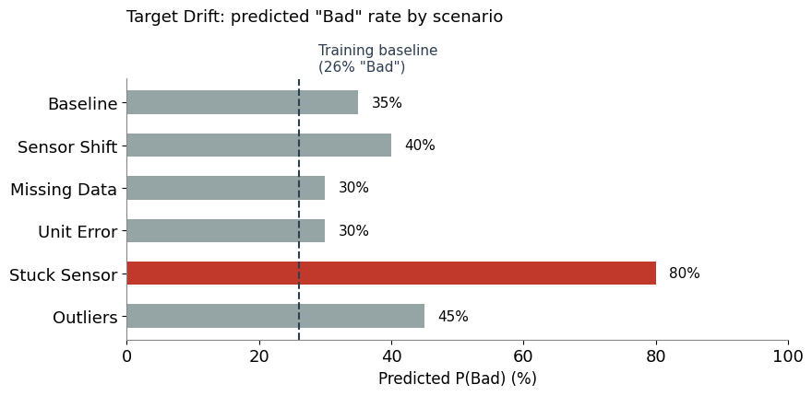
Appendix

Slide 21
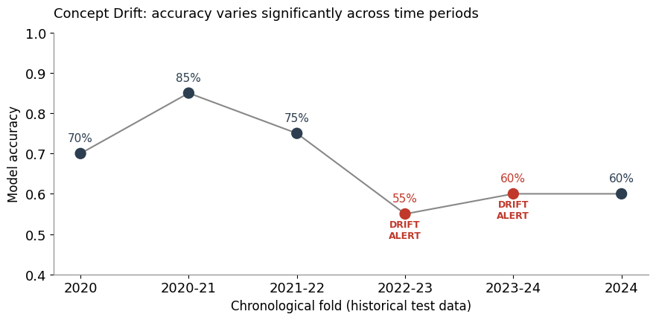
Appendix

Slide 22
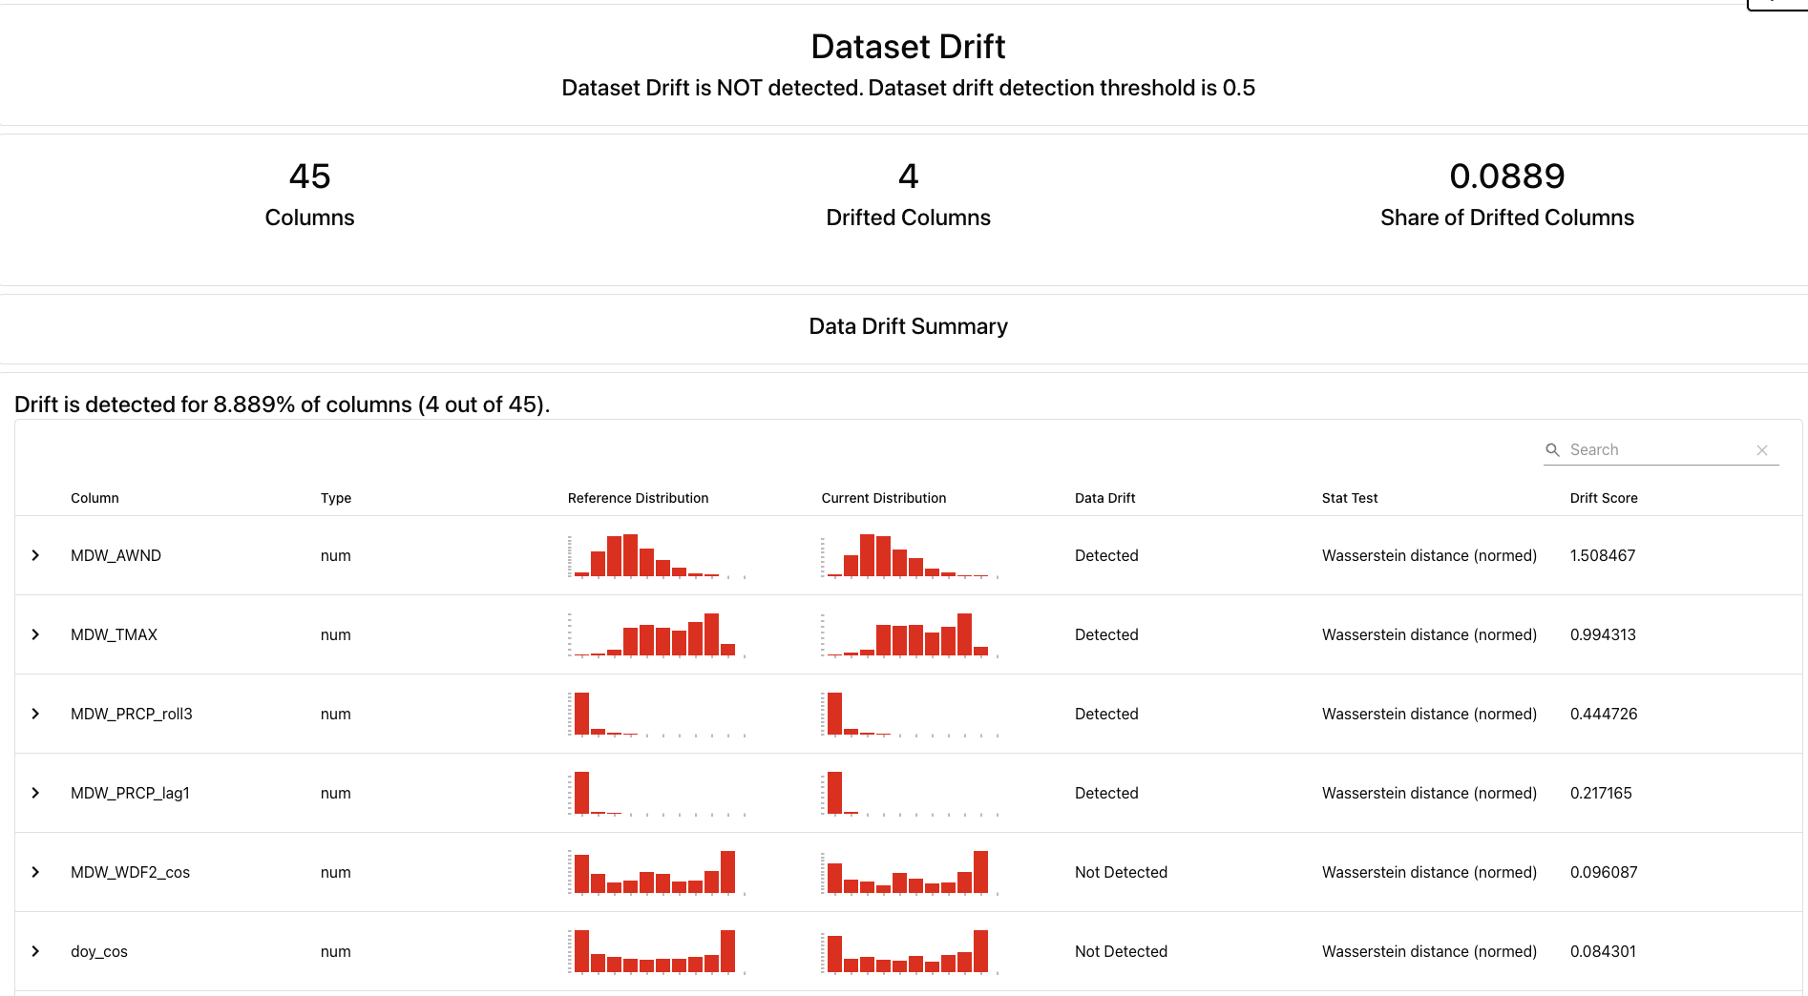
Appendix

